Slide 1



Keeletehnoloogia platvormi projektist
30.09.2021 ELRC seminar
Martin Luts
keeletehnoloog | Tilde
Agreement number: INEA/CEF/ICT/A2020/2278398 Action No: 2020-EU-IA-0082

Slide 2
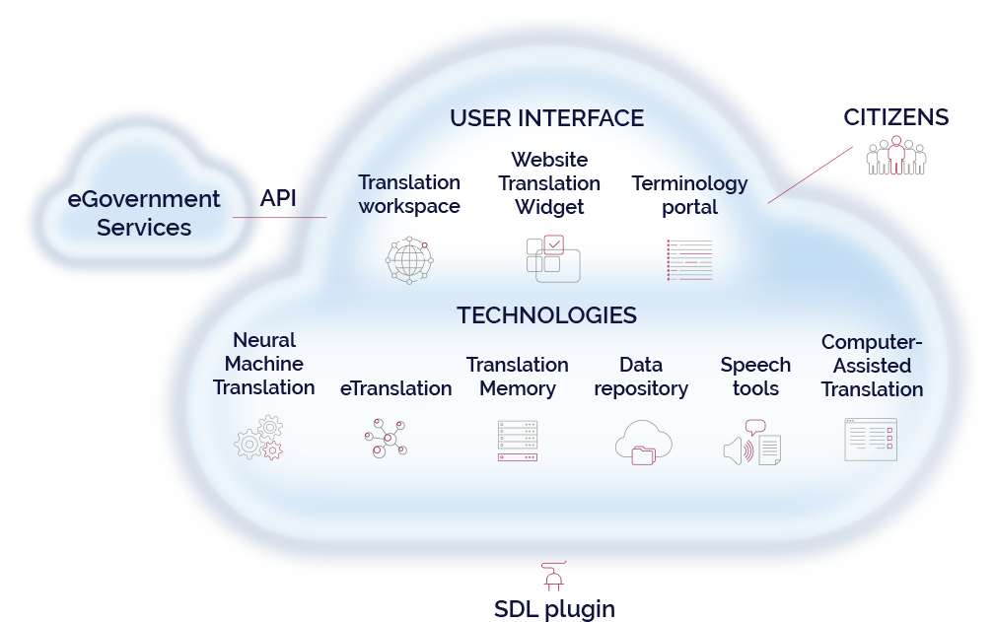
365 päeva pärast ehk 30.09.2022 on meil..
Task management
Available under open community license GPL or similar
Notes:
Functionalities: CAT incl management job tasks (ensure in scope wo details), TM handling
National Language Technology Platform (NLTP) Services

Slide 3












NLTP konsortsium
Eelarve 1 miljon eurot
Office of the State Advocate (OSA) ​Malta
Central State Office for the Development of Digital Society (RDD) Croatia ​
Notes:
NLTP partners:
TILDE ​(Coordinator) Estonia/Latvia
University of Tartu (UTARTU) Estonia
Culture information systems centre (CISC) ​Latvia
Malta Information Technology Agency (MITA) ​Malta
Office of the State Advocate (OSA) ​Malta
L-Università ta' Malta (UM) ​Malta
Central State Office for the Development of Digital Society (RDD) Croatia ​
University of Zagreb, Faculty of Philosophy (FFZG) ​Croatia
Reykjavik University ​/ Iceland
National Language Technology Platform (NLTP) will combine all the latest AI-driven language technology solutions providing public administrations, SMEs and general public with an efficient way to ensure multilingual access to online services, websites, documents and information removing the language barriers, increasing accessibility and fostering cross-border services.
Each partner country will be able to customize, integrate and deploy NLTP according to their specific needs (language tools, MT engines, speech tools)
NLTP platform will be licenced under open community licence (with GPL, or a similar license)
Budget total: 1 061 547 EUR (incl.: NLTP dev. 392 476 EUR, Uni Tartu 115 560 EUR)

Slide 4
Võimalused Eestis kasutamiseks
Subtiitrite tõlge ERR
Turismiinfo tõlge EAS visitestonia.com
Riigi Teataja
… huvilised oodatud ühendust võtma!
Eesti nõuetele (sh turvalisus E-ITS/ISKE, AK dokumentide tõlge, MF nõuded jms) kohandatud NLTP platvormi “haru”
Eesti keele tarvis treenitud AI mudelid
Notes:
As the Government Office of Estonia, publishing Riigiteataja, the state gazette, publishing law and other legal updates
I need to swiftly translate the vast amounts of our content into other languages
So that residents and visitors that do not speak Estonian or English would get access to the information we publish
As the E-resident portal e-resident.gov.ee,
I need to translate the information on our portal into other languages
So that the current and future Estonia’s e-residents could learn about e-residence and get timely information about it in languages other than Estonian and English
CTA anyone interested to include a new US please contact

Slide 5
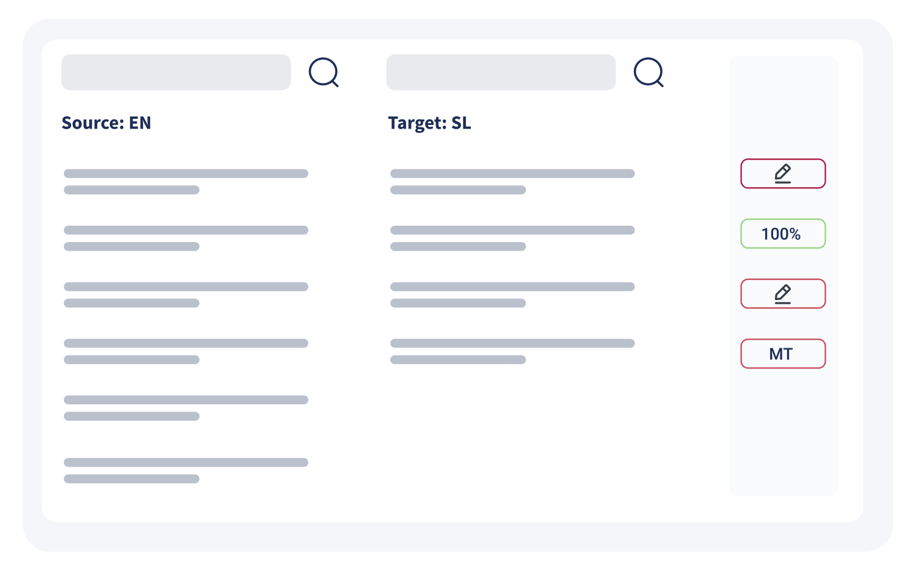
Online CAT tool Matecat
Machine Translation suggestions
Integration with translation memories
Integration with the Terminology platform data base
Ask sharing and progress overview
Translation and workflow management

Slide 6
Online TM NecTM
Stores the source text and its corresponding translation
Centralized environment for TM management
Different access levels and sharig
Connected to on-line CAT tool + can connect via plug-in to professional CAT tools for example SDL Trados Studio
Notes:
https://www.nec-tm.eu/wp-content/uploads/2019/03/Estonia-Report.pdf

Slide 7
Võimalused Eestile
Keeleagnostilisi komponente peaks arendama koostöös teiste riikidega
  Mitme osapoole tarkus
  Kulude jagamine
„omanikutunne“ – osaleme koos teiste riikidega väljatöötamisel ja edasiarendustes
Teiste eesti KT projektidega ühitamisel nii sisulises kui tehnilises vaates
Kontakt: martin.luts@tilde.ee

Slide 8
Current status and next steps
April 2021
July 2021
August 2021
November 2021
April 2022
June 2021
July 2022
October 2022
January 2023
1
2
3
Definition of requirements
Building the project involving community
Planning of the development activities
NLTP launch - March 2023

